Slide 1

LostGal Navigation App
Introducing LostGal: The navigation app that brings back the joy of getting hopelessly lost!

Slide 2
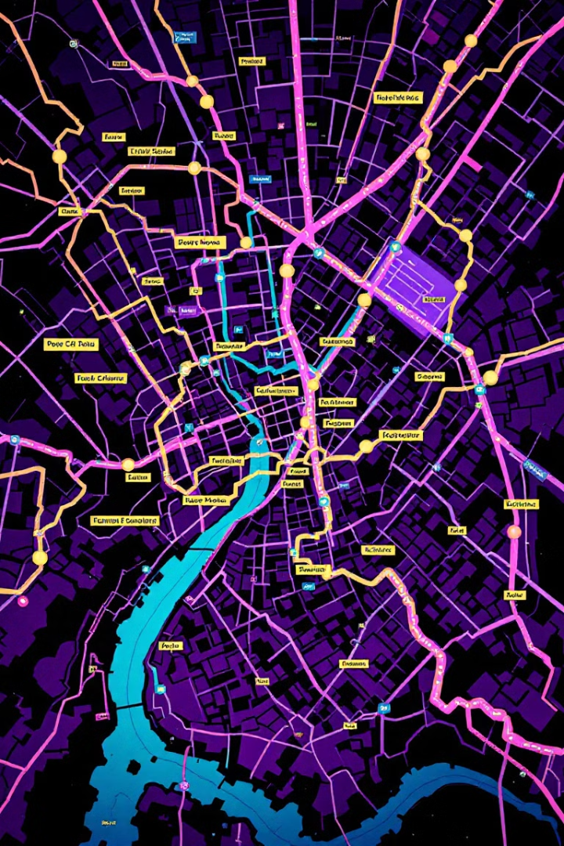
Embrace the Chaos of Navigation
Nostalgic Navigation
Confuse the
Tech-Savvy
Experience the thrill your parents or grandparents rave about by getting lost at every turn.
Silence complaints about modern navigation ease with our deliberately imprecise directions.
Adventure Awaits
Experience the unexpected detours and wrong turns that make every journey an adventure.

Slide 3
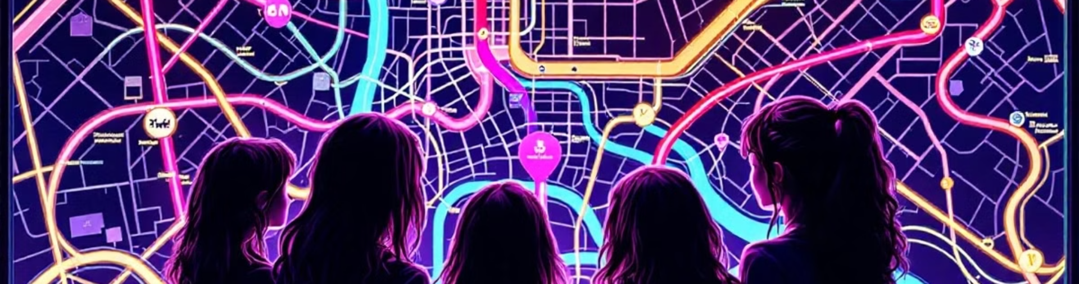




LostGal Features
Vague Directions
Scolding Alerts
Unreliable Maps
Enjoy confusing, imprecise instructions that guarantee a scenic route.
Experience the thrill of being screamed at when you dare to ignore our misguided advice.
Navigate with our intentionally outdated and inaccurate map system.
Ready for a wild ride? Download LostGal—if you dare!

